Slide 1








AI & Ideology
Module 3 – AI Governance, Ethics, Human Rights, and Democracy
Teaching Unit 4 – AI & Ideology

Slide 2

Content
Observation Task
Video: Generative AI and the aesthetics of digital fascism
Discourse Analysis

Slide 3
Observation Task
Prof. Dr. Roland Meyer:
Professor at University of Zürich, Switzerland
Image and media scholar
Talk was held at the German media conference re:publica 25
Watch Prof. Dr. Roland Meyer's lecture on AI and digital fascism. The lecture was originally held in German and has been dubbed into English. If you prefer another language, you can have subtitles for the lecture generated automatically. A German-language audio version is also available online.
Take notes to answer the following guiding questions in small groups after you watched the video:
1. Are AI systems neutral and objective? Why?
2. What power relations exist in the field of AI?
3. Explain in your own words why AI can be understood as a “political project”.

Slide 4
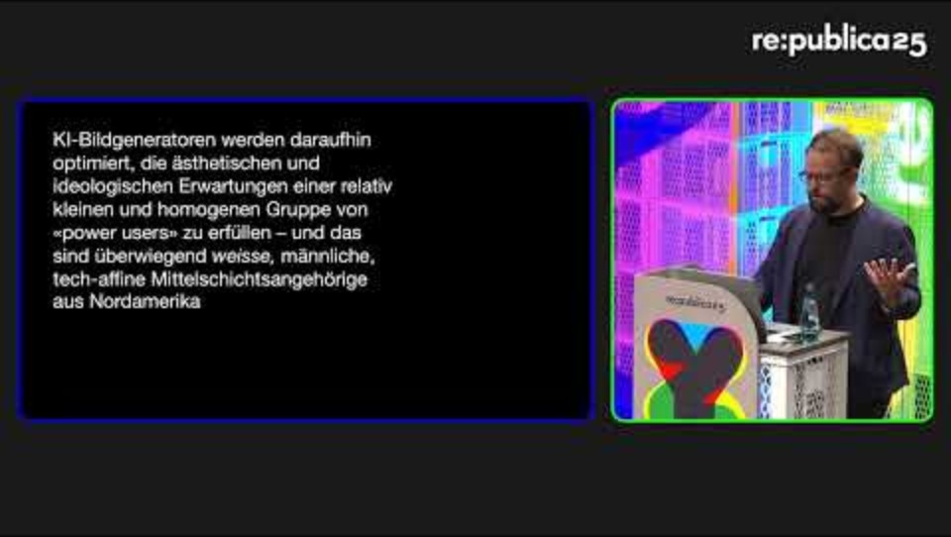
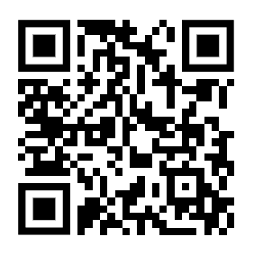
Generative AI and the aesthetics of digital fascism
Source: https://www.youtube.com/watch?v=nUK5Ibp0Th0
Published on YouTube by re:publica under the license CC BY-SA 4.0

Slide 5
Reminder: Observation Task
Prof. Dr. Roland Meyer:
Professor at University of Zürich, Switzerland
Image and media scholar
Talk was held at the German media conference re:publica 25
Watch Prof. Dr. Roland Meyer's lecture on AI and digital fascism. The lecture was originally held in German and has been dubbed into English. If you prefer another language, you can have subtitles for the lecture generated automatically. A German-language audio version is also available online.
Take notes to answer the following guiding questions in small groups after you watched the video:
1. Are AI systems neutral and objective? Why?
2. What power relations exist in the field of AI?
3. Explain in your own words why AI can be understood as a “political project”.

Slide 6
Discourse Analysis
Task:
Conduct a reduced discourse analysis in small groups. You can divide the workload among the members of your group. Make sure you reserve some time at the end to bring together your results before sharing them in the plenum. Use the following steps as guidance:
Working Steps:
Search for keywords: Which words/topics appear repeatedly?
Recognise patterns of argumentation: Which arguments are used to explain or justify something?
Identify exclusion mechanisms: Which perspectives are missing? Who is not being heard?
Examine power relations: Who is allowed to speak about the topic, and how?

Slide 7
Results Presentation

Slide 8
Sources
re:publica (2025, July 7). [EN] re:publica 25: Roland Meyer - Generative AI and the aesthetics of digital fascism [Video]. YouTube. https://www.youtube.com/watch?v=nUK5Ibp0Th0

Slide 9


Thank you for your interest and attention.
Funded by the European Union. Views and opinions expressed are however those of the author(s) only and do not necessarily reflect those of the European Union or the European Education and Culture Executive Agency (EACEA). Neither the European Union nor EACEA can be held responsible for them.
Project No: KA220-VET-000165375
Copyright © 2026 by the partner consortium of the project “AI.D – Artificial Intelligence and the Shaping of Democracy”
This work is licensed under CC BY-SA 4.0

